Slide 1

Design and Development of a RAM-based PUF
Zissis Tabouras (s284685)
Elena Roncolino (s304719)
Stefano Palmieri (s281677)

Slide 2
What is a PUF?
Physical Unclonable Function
Extracts secrets from physical characteristics of a device
Useful to implement authentication mechanisms
2

Slide 3
Why are PUFs important?
Reproducible
Unique
Unclonable
One-way
Unpredictable
3

Slide 4
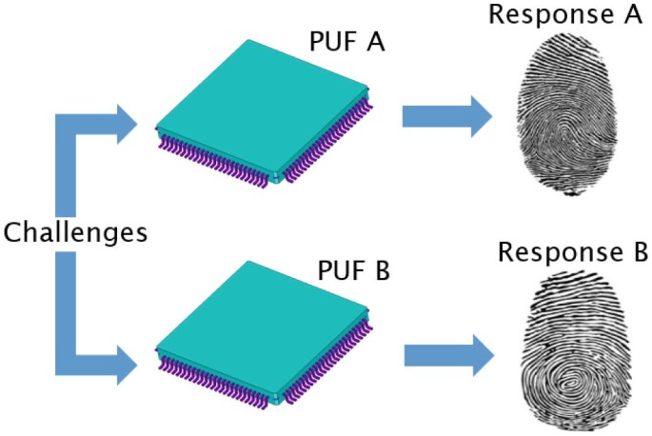
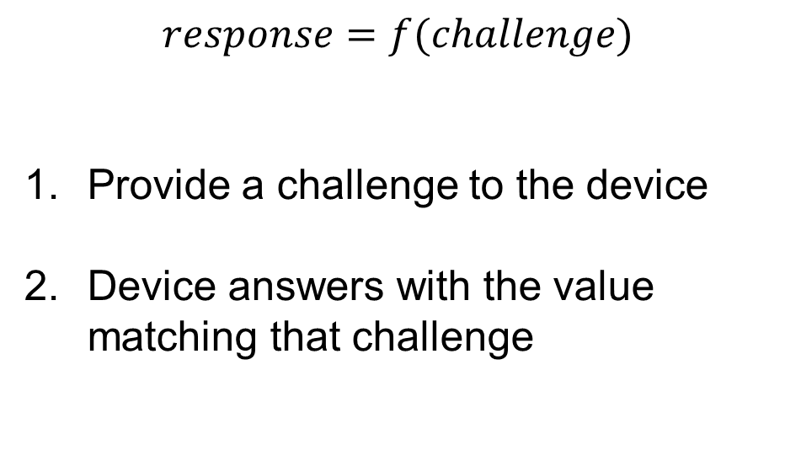
How does a PUF work?
$$response=f(challenge)$$
Provide a challenge to the device
Device answers with the value matching that challenge
4

Slide 5
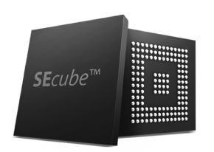
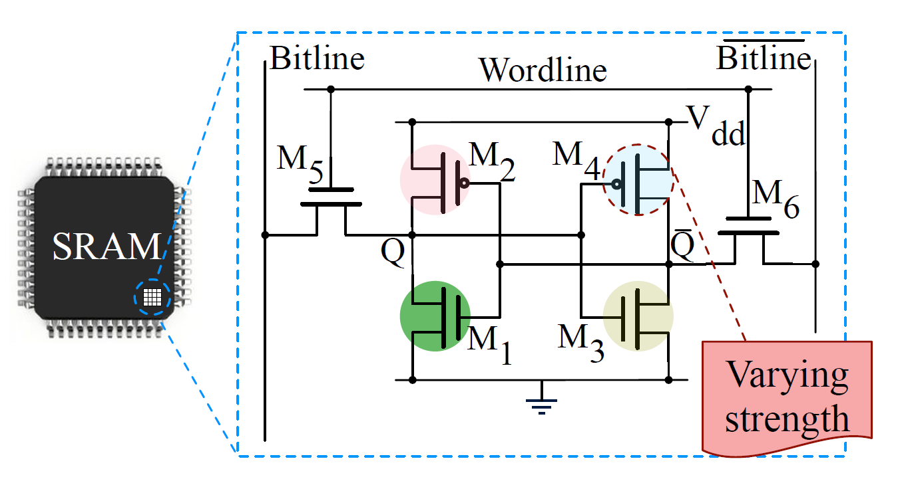
SEcube™ and SRAM PUF
SEcube™: silicon embedding a processor, an FPGA and a smart card
SRAM in the SEcube™ used to extract PUFs
5

Slide 6
Implementation

Slide 7
Implementation
Two flows: 1. Host retrieves all the responses from the device 2. Challenge-response authentication mechanism between the host and the device
7
Notes:
Store SRAM content into flash memory
Access flash memory to retreive PUFs
Store PUFs in DB

Slide 8
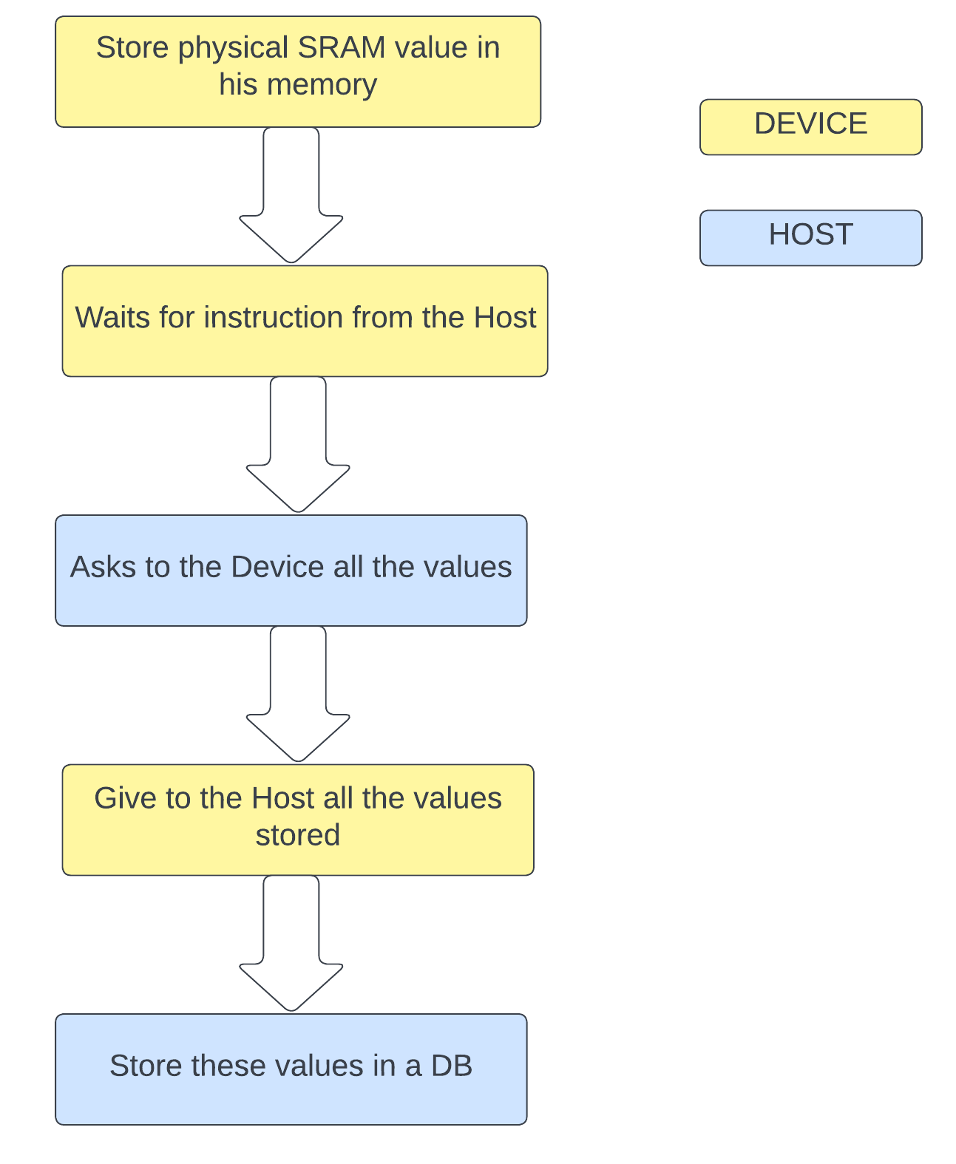
First flow
Host
Requests list of PUFs
Receives PUF list
Stores the list in a DB
Device
Stores SRAM content in FLASH (startup)
Sends list of PUFs
Notes:
PUF retrieval and DB initialization
Store SRAM content into flash memory
Access flash memory to retreive PUFs
Store PUFs in DB

Slide 9
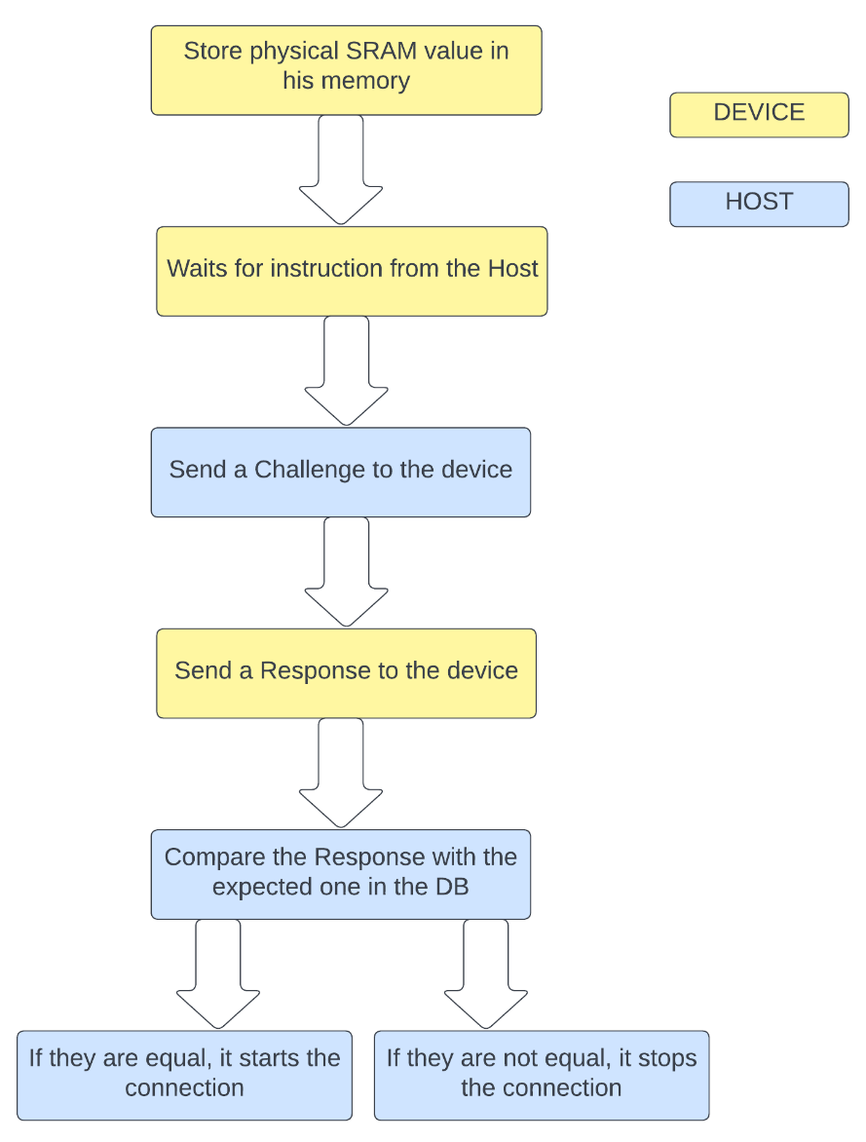
Second Flow
Host
Generates challenge
Sends challenge to board and DB
Compares responses (Hamming)
Device
Receives challenge
Sends response
Notes:
Application of a challenge and verification of device authenticity
Apply challenge to DB and board
Retreive board response
Perform response matching

Slide 10
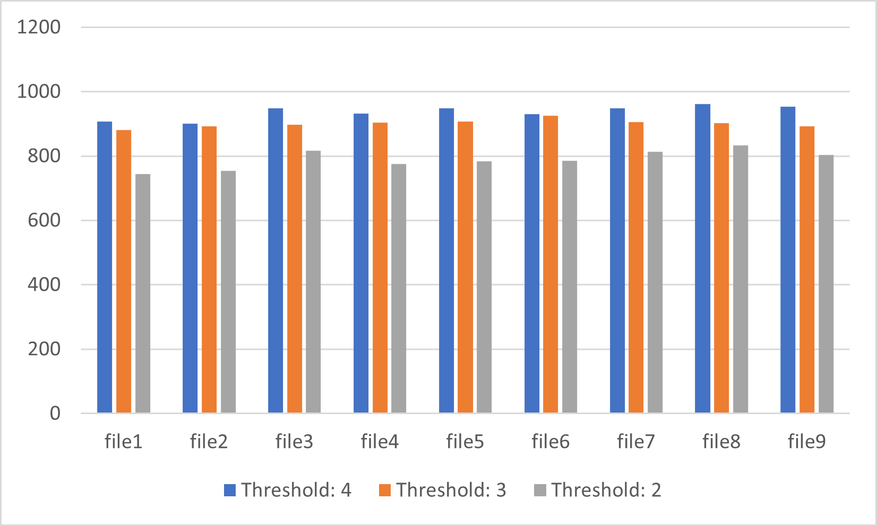
Results
Thresholds:
2 -> 79,00% of accurancy
3 -> 90,10% of accurancy
4 -> 93,67% of accurancy

Slide 11
Example on the board

Slide 12
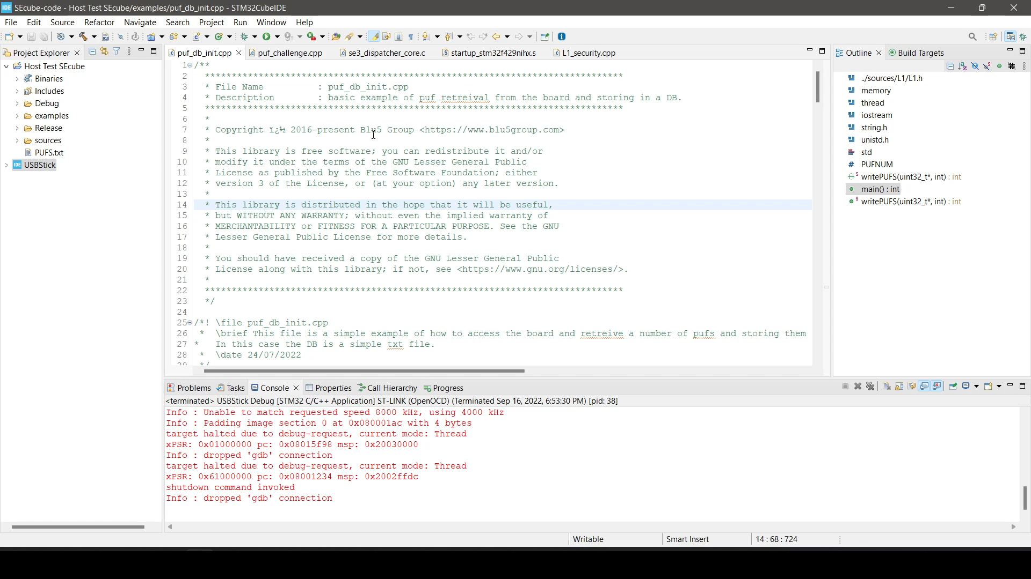
Flow 1

Slide 13
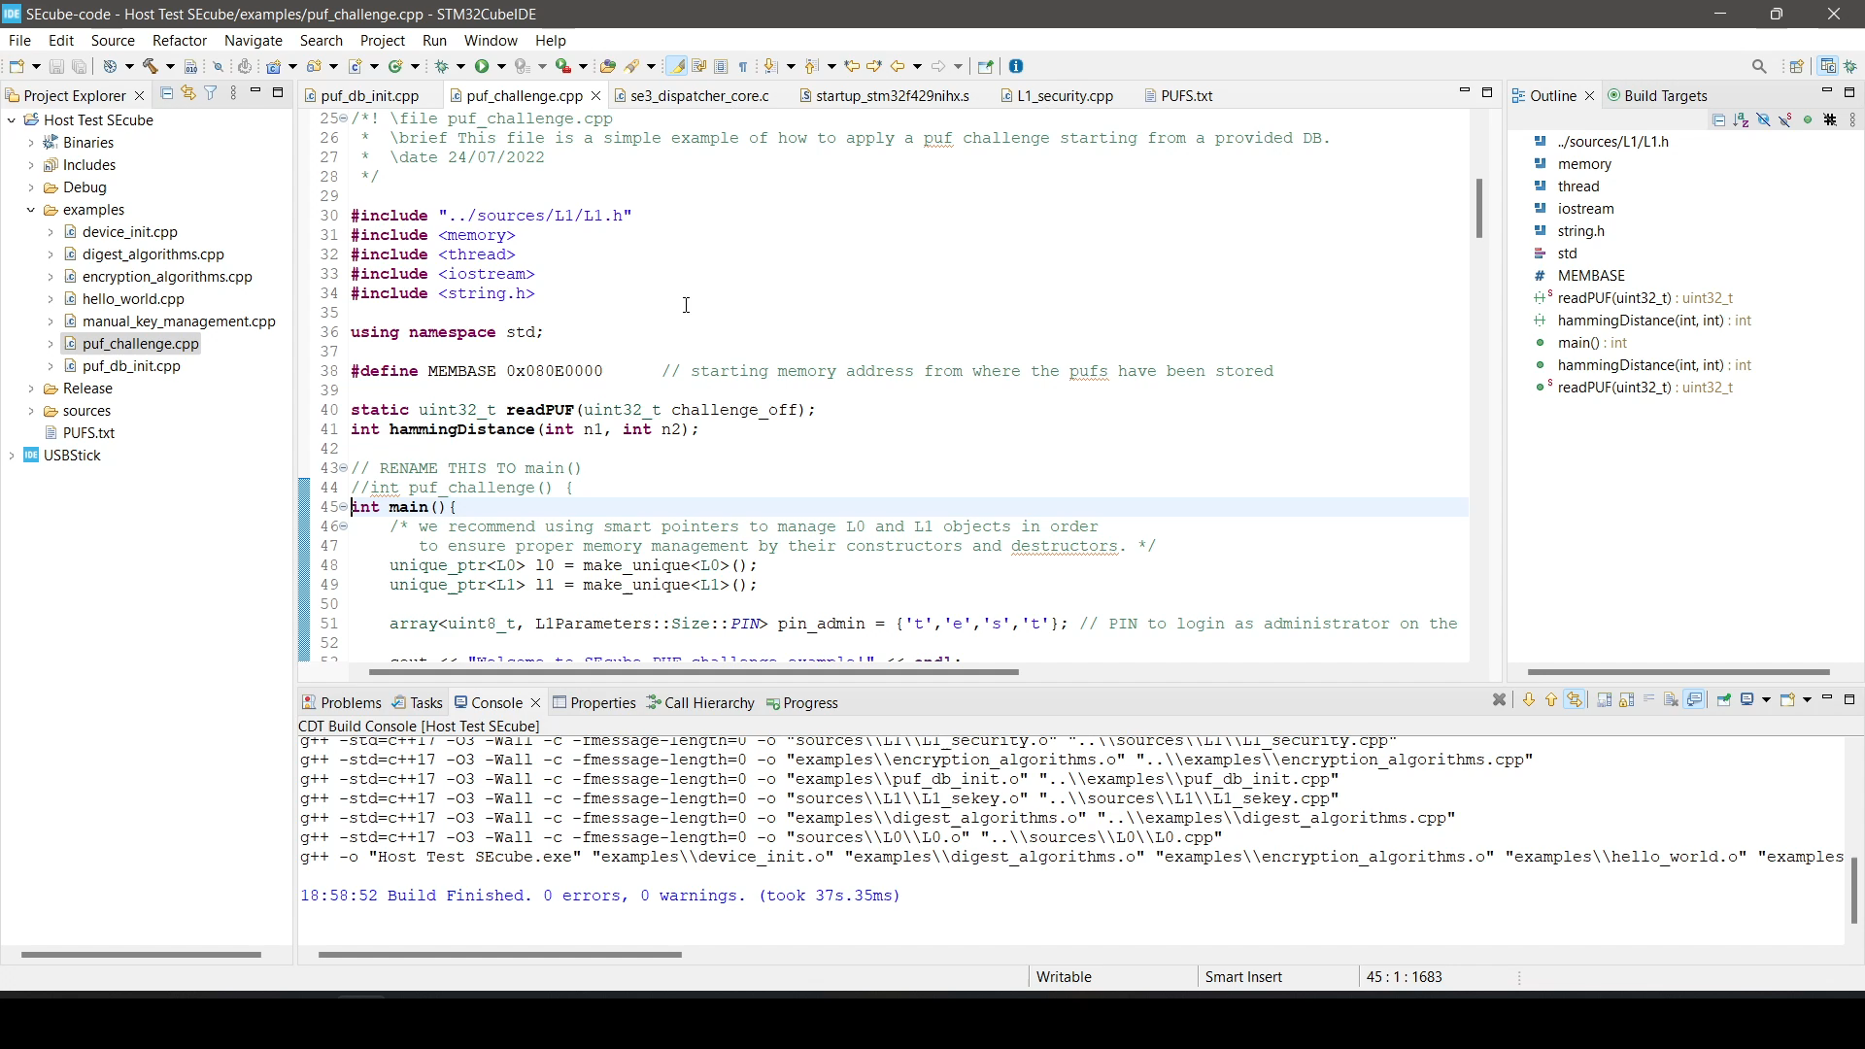
Flow 2

Slide 14
